Slide 1
NeuRes
Introduction to Deep Learning
A webinar by Data Science Community

Slide 2


Your speakers for today
Aarsh Chaube
Shinjinee Maiti

Slide 3
Topics for today
What is Deep learning?
Neural networks
Perceptron model
Activation functions
Cost function
Optimization
Gradient Descent
Hands-on session: Studying a pre-prepared Colab notebook

Slide 4
What is Deep Learning?
Deep Learning is a sub-field of machine learning concerned with algorithms inspired by the structure and function of the brain called Artificial Neural Networks (ANN).
Notes:
It imitates the workings of the human brain in processing data and creating patterns for use in detecting objects, recognizing speech, translating languages, and decision making.

Slide 5
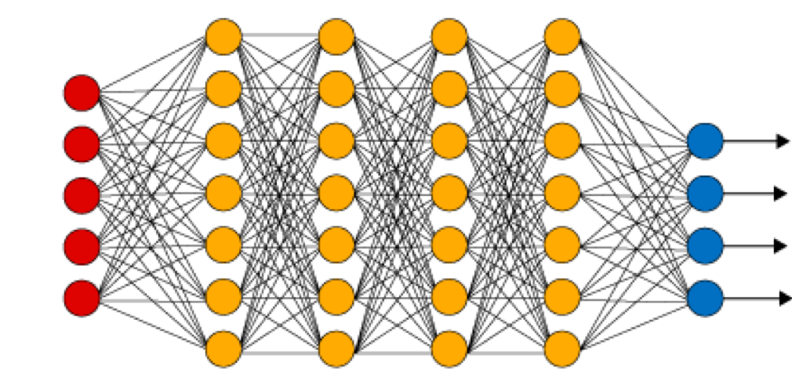
Neural Networks
Input Layer
Hidden Layers
Output Layer
Notes:
Input Layer:- It accepts input features. Providing information from the outside world to the network, no computation is performed at this layer, nodes here just pass on the information to the hidden layer.
Hidden Layer:- Nodes of this layer are not exposed to the outer world. The hidden layer performs all sorts of computation on the features entered through the input layer and transfer the result to the output layer.
Output Layer:- This layer brings up the information learned by the network to the outer world.

Slide 6
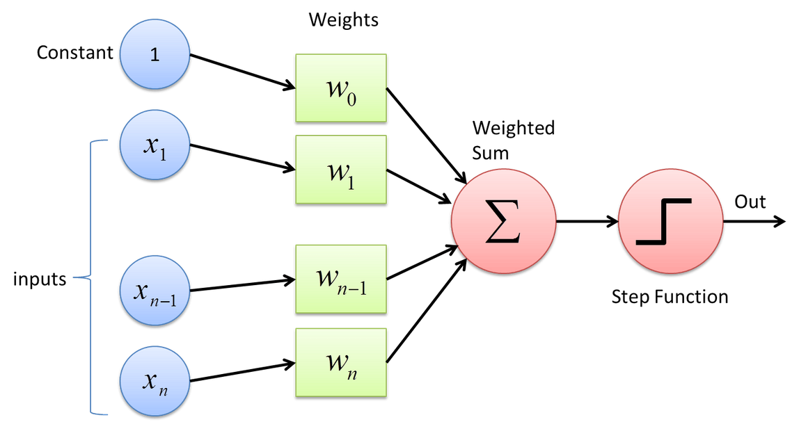
Perceptron Model
In the Artificial Neural Network(ANN), the perceptron is a convenient model of a biological neuron. The purpose behind the designing of the perceptron model was to incorporate visual inputs, organizing subjects or captions into one of two classes and dividing classes through a line.

Slide 7
Activation Functions
In ANN, Activation Functions define the output of that node given an input or set of inputs. It basically decides whether the neuron should be activated or not.
x = (weight * input) + bias

Slide 8
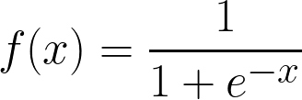
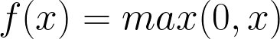
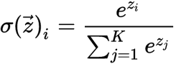
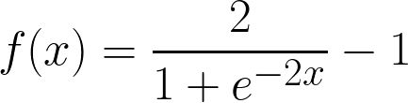
Types of Activation Functions
Sigmoid
Tanh
ReLU
Softmax

Slide 9
Family of Cost Functions

Slide 10
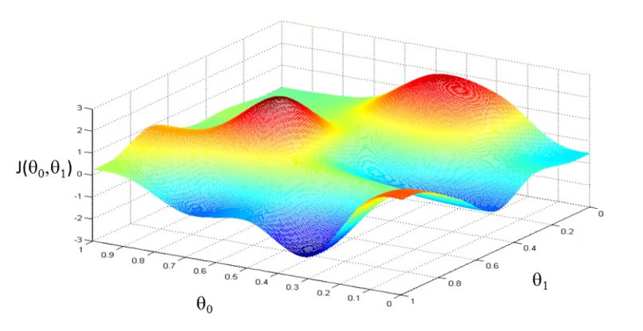
What is a Cost Function?
1
The cost function (also called the loss function) is a single value.
The farther off the neural network prediction is from the desired output, the higher the cost function.
2
3
As training continues, the error decreases. As a result, the cost function decreases as well.
We can conclude that to train the neural network, our goal is to minimize the cost function.
4

Slide 11


Cost Function Formula
This function is called the Mean Squared Error (MSE) or the Quadratic loss.

Slide 12

Cost Function Formula
1. Binary Cross Entropy Loss (used with Sigmoid activation):
2. Cross Entropy Loss (used with Softmax activation):

Slide 13
Break-time!
Head over to our discord server to interact with our community members!
Data Science Community Outer Circle
Do check out our other handles!
Email: datasciencecommunity@gmail.com
Instagram: dscommunity_srm
Twitter: dscommunity_srm
LinkedIn: Data Science Community SRM
YouTube: Data Science Community SRM

Slide 14

Concept of Optimization
Optimizers are algorithms used to change the attributes of the neural network such as weights and learning rate to reduce the losses. Optimizers are used to solve optimization problems by minimizing the function.
Optimizers we'll be covering today
Stochastic Gradient Descent
Mini-Batch Gradient Descent

Slide 15
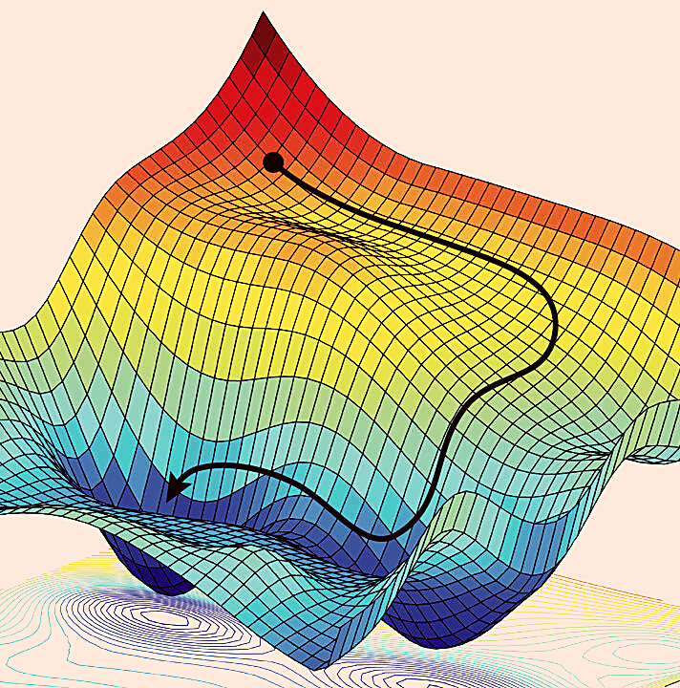
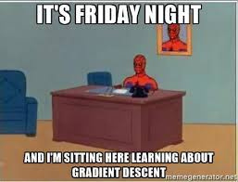
Gradient Descent
Tuesday

Slide 16
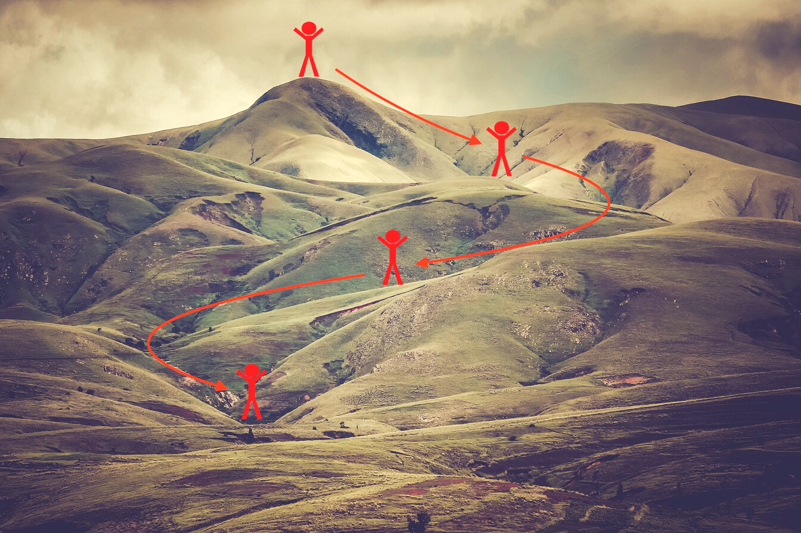



Intuition
Abhishek's Hiking story!

Slide 17
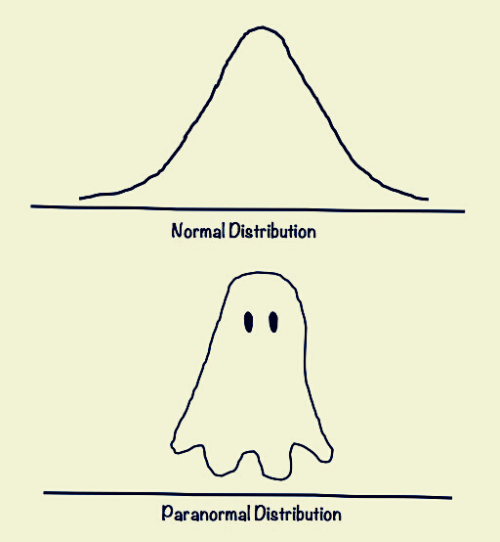


Getting into the math
The slope represents the function C while the ditch represents the minimum Cmin.
Mathematically this direction is the value of the partial derivative evaluated at point wr ,
reached at step r. Therefore, by taking the opposite direction the hiker can move towards
the ditch.
At each step, the hiker can decide how big a stride to take before the next stop. This is the
so-called "learning rate" >=0 in gradient descent jargon.

Slide 18



Hands-on time!

Slide 19



What's for tomorrow?
Artificial Neural Networks
Hands-on session: working with a custom-layered NN

